Slide 1

Linux Fundamentals and Basic Commands

Slide 2

Questions?
What is an Operating System?
Which Among three Following OS came first for use:
  Windows
  Linux
  UNIX
Which OS is most used?
Notes:
The answer of the first question is : An Operating System is a program that manages the resources (Computer Hardware, Software, Memory Etc.) of a computer. It provides an interface between the user and the hardware, and it also provides services that allow applications to run. Operating system is an interface between user and the hardware (CPU, memory, Network interface card,...... etc), It also manages other resources e.g. : I/O management ,Job scheduling ,Device Management etc.
The answer to the second question is: UNIX was introduced in year 1969, where as Windows was in 1985 and Linux came far latter in 1990. Linux is the most widely used operating system as android phone is one among most used devices in the word and android is based on Linux Kernel.

Slide 3

Introduction to UNIX
Unix is a
  portable,
  multi-user,
  multi-tasking
  Multi-procession operating system.
  Written in “C” language
Developed by a group of AT&T employees at Bell Labs and Dennis Ritchie in 1969.
Unix has three major component
  Kernel,
  Shell
  Applications.
Notes:
‹#›
Unix is a portable, multi-user, multi-tasking, and Multi-procession operating system. Portable means the Unix OS can be ported to any hardware including Intel, AMD, Mobile, etc.
The meaning of Multi-user is that More than one user can access the system at the same time. More than one task can be performed simultaneously/parallel is called Multi-tasking. Multi-processing is Support more than one CPU at the same time
Unix OS was developed by a group of AT&T employees at Bell Labs in 1969 and Dennis Ritchie is called as the father of UNIX.
Unix was developed in C programming language

Slide 4
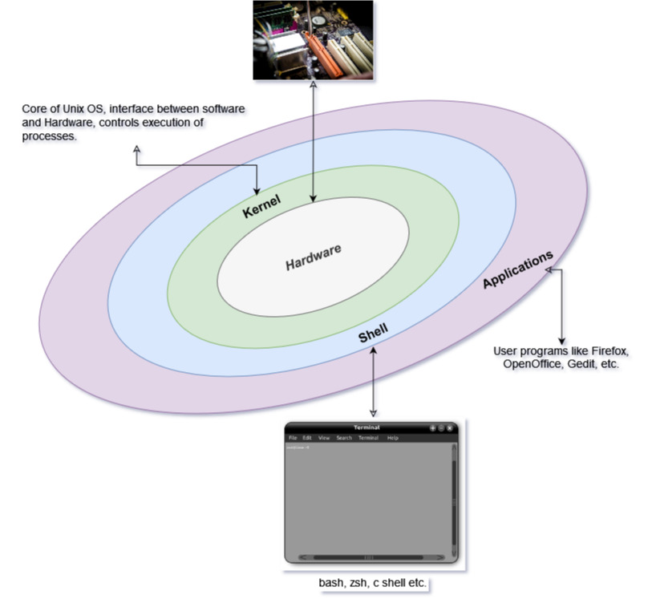
UNIX Architecture
Notes:
‹#›
Figure shows a typical architecture of a UNIX system. As shown, UNIX has 3 major components (The kernel, shell, and the user applications)
Kernel :The UNIX kernel is the core component of the UNIX operating system. It provides basic system services such as process management, memory management, and file system management. It also provides networking support and various other features. The kernel communicates directly to the computer hardware with assembly language (ie. Zeros and Ones)
Shell: A Unix shell is a command-line interpreter that provides a traditional user interface for Unix-like operating systems. Shell is an interface between the user application and the kernel. Shell will take command from the user and it will translate to a “C” program and will be provided to the kernel. It interprets all commands to the kernel & process all the response back from the kernel.
User programs: It is the Application programs that directly interact with a user. Unix programs are a type of software that helps users to complete tasks on a Unix-based operating system. These programs can be used to manage files, edit text documents, and more.
Yes, we can definitely map the architecture of a UNIX system to the analogy of a restaurant! Here's how:
The Restaurant Analogy for a UNIX System:
The Kernel = The Kitchen (and the Head Chef/Manager)
Core Function: This is where the real work gets done. The kitchen is responsible for preparing all the food (like the kernel manages processes, memory, and files).
Direct Hardware Interaction: The chefs and kitchen staff directly handle the ingredients, cooking equipment, and appliances (the kernel interacts directly with the computer hardware in assembly language). They understand the fundamental operations.
Basic Services: The kitchen provides the basic services of a restaurant – preparing the meals.
The Shell = The Waiter/Waitress (or the Order Taker/Translator)
Interface: The waiter/waitress is the interface between the customers (user applications) and the kitchen (kernel). They take orders from the customers.
Command Interpretation/Translation: When a customer orders "pasta," the waiter translates that into what the kitchen understands (e.g., "prepare spaghetti carbonara with extra parmesan"). This is like the shell taking a user command and translating it into a C program for the kernel.
Processing Response: Once the food is ready, the waiter brings it back to the customer, communicating the "response" from the kitchen. Similarly, the shell processes the response from the kernel and presents it to the user.
User Programs = The Customers
Direct Interaction: Customers directly interact with the waiter to get their needs met (user programs directly interact with the user to accomplish tasks).
Variety of Needs: Different customers have different requests – some want appetizers, some main courses, some dessert. This is like various user programs performing different tasks (managing files, editing text, etc.).
Dependence: Customers rely on the restaurant (the UNIX system) to fulfill their desires.

Slide 5
UNIX Distributions
Commercial
🡪 Solaris:
http://www.oracle.com/us/products/servers-storage/solaris/solaris11/overview/index.html
🡪 AIX: http://www-03.ibm.com/systems/power/software/aix/
🡪 HP-UX: http://www8.hp.com/us/en/products/servers/hp-ux.html
🡪 MAC OS: http://www.apple.com/osx/
🡪 Tru64 UNIX : http://h30097.www.hp.com/
Free
🡪 FreeBSD : http://www.freebsd.org/
🡪 NetBSD: http://www.netbsd.org/
🡪 OpenBSD: http://www.openbsd.org/
http://upload.wikimedia.org/wikipedia/commons/7/77/Unix_history-simple.svg
Notes:
‹#›
Unix distribution has 2 categories commercial & free Commercial: You Have to pay and use. It is been given by some organization
Solaris is one of the commercial vendor for Unix. It is Unix OS owned by Oracle, earlier it was owned by Sun Microsystems.
AIX is a Unix-based operating system developed and marketed by IBM. It was developed for IBM hardware like IBM's POWER systems. IBM also has supercomputers and a supercomputer is a computer that is significantly faster than a typical computer. AIX is preferred for supercomputers because it is stable, reliable, and can be customized to meet the specific needs of the high-performance computing environment. AIX OS cannot be installed on normal computer systems. it can only be installed on IBM hardware.
HP-UX is developed by Hewlett Packard (HP) for its line of Unix-based servers and workstations. It stands for "Hewlett Packard Unix". HP-UX is designed to run on a wide range of hardware, from small desktop systems to large enterprise servers and supercomputers. It includes features such as logical volume management, high-availability clustering, and support for multiple processors and large amounts of memory. HP-UX is used in a variety of industries, including finance, healthcare, telecommunications, and government, where high availability and reliability are critical requirements.
MACOS is the UNIX OS developed by Apple Inc. for its Macintosh line of computers. It was previously known as Mac OS X or OS X. macOS is a Unix-based operating system that is known for its user-friendly interface, elegant design, and integration with Apple's other products such as iPhone, iPad, and Apple Watch. MACOS also has a robust security system, including built-in encryption and protection against malware and other threats.
Tru64 UNIX developed by Digital Equipment Corporation (DEC), which was later acquired by Compaq and then Hewlett-Packard (HP). Tru64 was originally called Digital UNIX, but it was later renamed to Tru64 UNIX to reflect its compliance with the Single UNIX Specification. Tru64 was designed to run on DEC's Alpha architecture, which was a 64-bit processor that offered high performance and scalability. It included features such as clustering, advanced file system management, and support for multiple processors and large amounts of memory. Tru64 was widely used in scientific, engineering, and financial industries, but development of the operating system.
We have some Free Unix distributions. we can Download & use it freely
FreeBSD is a free and open-source Unix-like operating system that is based on the Berkeley Software Distribution (BSD) Unix operating system. It was originally developed at the University of California, Berkeley and is now maintained by a community of developers. FreeBSD is known for its advanced networking and security features, as well as its scalability and reliability. It can be used for a wide range of applications, from desktop and server systems to embedded devices and supercomputers. FreeBSD is also widely used as the operating system for web servers, database servers, and other network services. It is licensed under a permissive BSD license, which allows for both commercial and non-commercial use and modification of the source code.
NetBSD is a free and open-source Unix-like operating system that is based on the Berkeley Software Distribution (BSD) Unix operating system. It is known for its portability and support for a wide range of hardware platforms, including embedded devices, workstations, and supercomputers. NetBSD is designed to be secure, reliable, and scalable, with a focus on simplicity and ease of use. It includes a variety of features such as advanced networking and file system management, support for multiple processors and virtualization, and a large collection of pre-built software packages.
OpenBSD was originally derived from NetBSD and is known for its strong focus on security and code quality. OpenBSD includes a variety of security features, including strong cryptography, packet filtering, and privilege separation. It is also known for its portability and support for a wide range of hardware platforms.

Slide 6


Guess Who?
“A computer is like air conditioning - it becomes useless when you open
Windows.” Linus Torvalds
“Unix is Simple. Its Just Takes A genius to understand its Simplicity.” Dennis Ritchie
Notes:
First figure:
Linus Torvalds (the father of LINUX)
Linus Benedict Torvalds is a Finnish-American software engineer who is the creator and, historically, the lead developer of the Linux kernel, used by Linux distributions and other operating systems such as Android. He also created the distributed version control system ,Git.
Second figure:
Dennis Ritchie (the father of Unix)
Dennis MacAlistair Ritchie was an American computer scientist. He is most well-known for creating the C programming language and, with long-time colleague Ken Thompson, the Unix operating system and B programming language.

Slide 7

Linux Operating System
Unix Like OS.
A fully-networked 32/64-Bit Unix-like Operating System
  Unix Tools (grep, awk, sed etc)
  Compilers (cc, c++, java etc)
  Network Tools (telnet, ftp, ping, traceroute etc)
Linux has a complete development environment, including compilers, toolkits, and scripting languages
Multi-user, Multitasking, Multiprocessor
Its GUI based OS.
Coexists with other Operating Systems
Supports multiple hardware
Its an Open Sources
Notes:
Linux is a free and open-source Unix-like operating system that was first released in 1991 by Linus Torvalds, it has has all Unix tools, all compilers & all network tools.
Linux is widely used in a variety of applications, including servers, desktops, mobile devices, and embedded systems. It contains lots of scripting languages, compiler toolkits & complete development environment.
Like UNIX, Linux is also a Multi-user, Multitasking, Multiprocessing operating system.
Initially Linux had an advantage over Unix that it include X windows system which gives a graphical user interface (GUI).
It can co-exist with other operating systems , on the same hardware we can install 2 operating system but only one operating system can be booted at a time. This was an advantage earlier with Linux.
Linux supports a wide range of hardware architectures, including x86, ARM, and PowerPC, while Unix tends to be more focused on specific architectures.
The source code for Linux is available for free, and it can be modified and redistributed under the terms of the GNU General Public License.

Slide 8
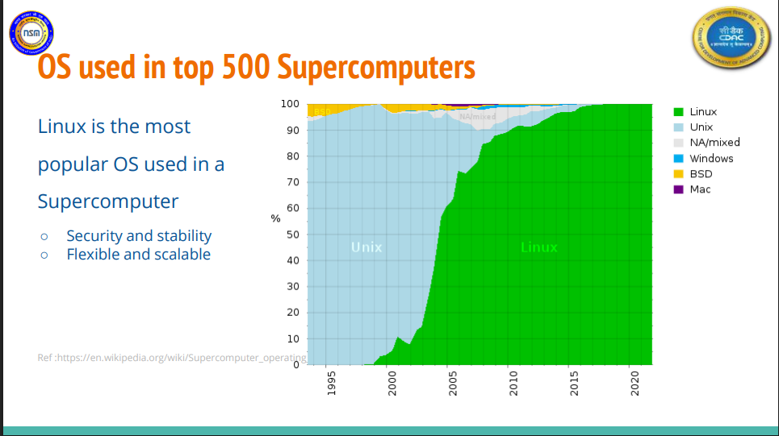

Slide 9
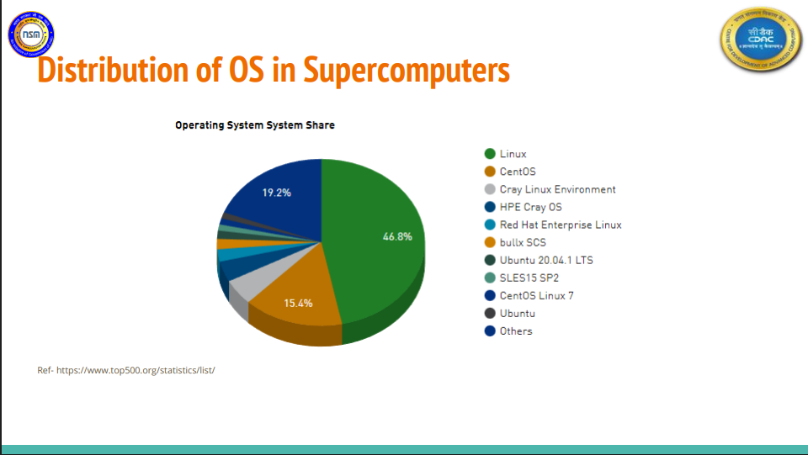

Slide 10

What is Open Source Software?
Free
  Here, ‘free’ does not refer to payment or non-payment, rather it is related to the ‘freedom’ and ‘control’ rights that is passed on to users so that they can run the software, study it, change it, and also share.
Source Code
  The source code must be made available (so that the receiving party will be able to improve or modify it).
The license
  Software can be redistributed under some license
Notes:
In Open source the software is made available to the users with its source code, which is the programming code that programmers write to create the software, and this code is open and freely accessible. This means that anyone can view, modify, and distribute the code without any restrictions, as long as they comply with the terms of the open source license under which the software is released. Open source software is typically developed by communities of volunteers, and it is often available for free.
The OSS has three component:
Free: Open-source software has the freedom to modify the content of the source code
Source Code: source code is been along given with the OS.
The License: Every open-source operating system has a license to redistribute it.
The source has been given to you and they are given freedom also to modify the source code but that freedom is mentioned under some license

Slide 11
Types of Licenses
GPL: GNU General Public License
  if you distribute copies of a program, either for a charge or for free, you have to pass onto the recipients the same freedoms that you received earlier, and also pass on the source code to subsequent users.
BSD: Berkeley Software Distribution
  Anyone can incorporate the program’s source code into another program. They don’t have to release their changes back to the community.
Notes:
Mainly there are 2 types of licenses
GPL stands for "General Public License". It is a widely-used open source software license that was created by the Free Software Foundation (FSF). The GPL license grants users the right to use, modify, and distribute the software freely, as long as they also make the source code available and distribute their modifications under the same license. The GPL is considered a strong copyleft license, which means that it requires anyone who distributes the software, or a modified version of it, to also make the source code available under the same license terms. Therefore whatever freedom you get in open source software then you should pass to the new user while you distributing it.
BSD license is a permissive license that allows anyone to use, modify, and distribute the software for any purpose, including commercial use, without any obligation to share their changes or modifications.If you modify the source code then they don’t have to release their changes back to the community

Slide 12
History of Linux
1985 - Minix Project
1991 – Linux
1992 - Softlanding Linux System
1993 – Debian, Slackware and Red Hat
1994 – Linux Kernel 1.0
1996 – GNOME Desktop Environment
2001 – Ubuntu
2003 – Linux Kernel 2.6
2007 - Android
Notes:
In 1985, Professor Andy Tannenbaum creates a UNIX like operating system based on System V Unix for the IBM PC & PC/AT computers and It is called as a Minix, it is developed as a teaching tool to demonstrate the inner workings of an operating system. It is known for its simple, modular design, and for its use as a basis for the development of other operating systems, such as Linux.
Based on the concept of Minux, Linux was developed in the early 1990s by Linus Torvalds, a computer science student at the University of Helsinki in Finland. Torvalds was interested in operating systems and wanted to create a free and open-source alternative to the Unix operating system, which was then popular in academic and research environments but was not widely available or affordable for most users.
In 1991: Linus Torvalds creates the first version of the Linux kernel, based on the MINIX operating system and the GNU toolchain.
1992: The first Linux distribution, called "Softlanding Linux System" (SLS), is released.
1993: The first versions of popular Linux distributions such as Debian, Slackware, and Red Hat are released.
1994: The Linux kernel reaches version 1.0 and becomes stable enough for production use.
1996: The first version of the GNOME desktop environment is released, providing a user-friendly graphical interface for Linux.
2001: The first version of the Ubuntu Linux distribution is released, providing a popular and user-friendly alternative to other Linux distributions.
2003: The Linux kernel reaches version 2.6, introducing many new features and improvements.
2007: The first version of the Android operating system is released, based on the Linux kernel and designed for mobile devices

Slide 13
LINUX Distributions
Android: http://www.android.com/
RedHat: http://www.redhat.com/en
  Fedora: https://getfedora.org/
openSuSE: http://www.suse.com/
Debian: http://www.debian.org/
  Ubuntu: http://www.ubuntu.com/
  Kali Linux: http://www.kali.org/
Linux Mint : http://www.linuxmint.com/
Chromium OS: http://www.chromium.org/chromium-os
http://distrowatch.com/dwres.php?resource=popularity
Notes:
‹#›
Android
Android is a mobile operating system developed by Google that is used on a variety of smartphones, tablets, and other devices. It is based on the Linux kernel and designed primarily for touchscreen devices. Android allows users to access a wide range of apps and features, including web browsing, email, messaging, and social networking, as well as the ability to customize the appearance and behavior of their devices.
RedHat - Red Hat Linux was a popular Linux distribution that was developed and distributed by Red Hat, Inc. It was one of the first commercially-supported Linux distributions and was known for its stability, reliability, and enterprise-level features. Red Hat Linux was based on the open-source Linux kernel and included many free and open-source software packages, such as the GNOME desktop environment, the Apache web server, and the PostgreSQL database server. Red Hat Linux was discontinued in 2004, and its successor, Red Hat Enterprise Linux, became the primary focus of Red Hat's enterprise offerings.Red Hat Enterprise Linux operating system is based on the open-source Linux platform and designed for use in data centers, servers, and other enterprise environments.
Fedora is a popular and widely-used Linux distribution that is sponsored by Red Hat, Inc. It is a community-driven project that is known for its cutting-edge features, rapid development cycle, and emphasis on open-source software. Many of the features and technologies developed for Fedora are later incorporated into Red Hat Enterprise Linux.
OpenSUSE: openSUSE is a popular and widely-used Linux distribution that is sponsored by SUSE Linux GmbH and other companies. It is a community-driven project that is known for its stability, ease of use, and strong support for open-source software. It is available in several different editions, including a desktop edition, a server edition, and a rolling release edition. openSUSE is often used by developers, system administrators, and enthusiasts who want a powerful and customizable operating system that is based on open-source software.
Debian - Debian is a popular and widely-used Linux distribution that is known for its stability, reliability, and strong support for free and open-source software. It is a community-driven project that is maintained by a large group of volunteers from around the world. Many other Linux distributions, including Ubuntu and Kali are based on Debian.
Ubuntu is a popular and widely-used Linux distribution that is based on Debian Linux. It is a community-driven project that is known for its ease of use, stability, and strong support for open-source software. It is designed to be easy to install and use, with a user-friendly graphical interface and a large software repository that includes a wide range of free and open-source software. Ubuntu is often used by home and office users, as well as developers and system administrators who value its ease of use and strong support for open-source software.
Kali Linux is a popular and widely-used Linux distribution that is focused on penetration testing, digital forensics, and ethical hacking. It is a community-driven project that is based on Debian Linux and includes many tools and resources that are specifically designed for cybersecurity professionals and enthusiasts. It is often used by security professionals and cybersecurity students to learn about and test various security techniques and methodologies.
Linux Mint - Linux Mint is a popular and widely-used Linux distribution that is known for its ease of use, user-friendly graphical interface, and strong support for multimedia applications. It is a community-driven project that is based on Ubuntu Linux and is designed to be a simple and accessible operating system for home and office users. Linux Mint is often used by people who are new to Linux or who want an operating system that is easy to install and use.
Chromium OS - Chromium OS is an open-source operating system that is based on the Google Chrome web browser. It aims to build an operating system that provides a fast, simple, and more secure computing experience for people who spend most of their time on the web. It is developed and maintained by the Chromium OS project, which is a community-driven project that is sponsored by Google.

Slide 14
Linux vs. Unix
Linux | Unix
Freely distributed, downloaded freely | Different cost structures according to vendors
Used by home users to developers | Developed mainly for mainframes, servers and workstations except OSX
kernel is developed by the community | Mostly maintained by commercial vendors.
File system supported Ext2, Ext3, Ext4, Jfs, ReiserFS, Xfs, Btrfs, FAT, FAT32, NTFS | jfs, gpfs, hfs, hfs+, ufs, xfs, zfs format
Supports multiple hardware from mobile phones, tablets, video game consoles, to mainframes and supercomputers. | Used in internet servers, workstations & PCs. Backbone of the majority of finance infrastructure and many 24x365 high availability solutions.
Notes:
The table shows the few of the major differences between LINUX and UNIX Operating Systems.
One of the biggest differences is that Unix is a proprietary operating system that is owned by various companies, such as IBM, HP, and Oracle, while Linux is an open-source operating system that is freely available and can be modified by anyone.
Another difference is that Unix is generally considered to be more stable and secure than Linux, due to its long history of development and use in mission-critical environments. However, Linux has a larger user base and community support, which means that it is more widely used and has more software and hardware support than Unix.
Linux is typically used by used by home users to developers whereas but Unix is mainly used by mainframes, servers, and workstations.
Linux supports lots of file systems even it supports windows file systems like FAT, FAT32, and NTFS so we can access the portion of the window in Linux but Unix can’t.
Linux supports almost every hardware but Unix support a few servers, workstations & PCs. Unix is the backbone of the majority of finance infrastructure.

Slide 15
Hardware Requirements
Can run on very minimal hardware
Recommend that computer have minimum of:
  1 GB of free disk space
  64 MB of RAM
For Red Hat Enterprise Linux installations:
  256 MB of RAM
  300 MHZ CPU
  800 MB of free disk space
Notes:
The hardware requirements for Linux can vary depending on the specific distribution and use case, but in general, Linux is known for being lightweight and efficient, and can run on a wide range of hardware configurations.
Typically, a computer with a modern processor, at least 1 GB of RAM, and a few gigabytes of storage space should be sufficient to run most Linux distributions. If you are using RedHat you need 256 MB of RAM & 800 MB of free disk space
For CentOS 8GB of RAM & 200GB of free space are Required

Slide 16
Centos8-Stream Installation
To install CentOS 8 Stream, you can follow these general steps:
  Download CentOS8 Stream from “https://www.centos.org/download/”
  Follow the on-screen instructions to start the installation process.
    Select your language and other preferences.
    Choose the installation destination and partition scheme for the operating system.
    Customize your software selection and enable or disable any additional features or repositories.
    Create your user account and password.
    Complete the installation and reboot your system.
Notes:
CentOS is a Community Enterprise Operating System, a free and open-source Linux distribution that is based on the Red Hat Enterprise Linux (RHEL) source code. It is known for its stability, security, and long-term support, making it popular for use in servers and enterprise environments. However, as of December 2020, CentOS has shifted its focus and is no longer offering new releases, but rather supporting CentOS Stream, which is a rolling release distribution.
To install CentOS 8 Stream, you can follow these general steps:
Download the CentOS 8 Stream ISO image from the CentOS website.
Create a bootable installation media such as a USB drive or DVD.
Insert the installation media into your computer and boot from it.
Follow the on-screen instructions to start the installation process.
Select your language and other preferences.
Choose the installation destination and partition scheme for the operating system.
Customize your software selection and enable or disable any additional features or repositories.
Create your user account and password.
Complete the installation and reboot your system.

Slide 17
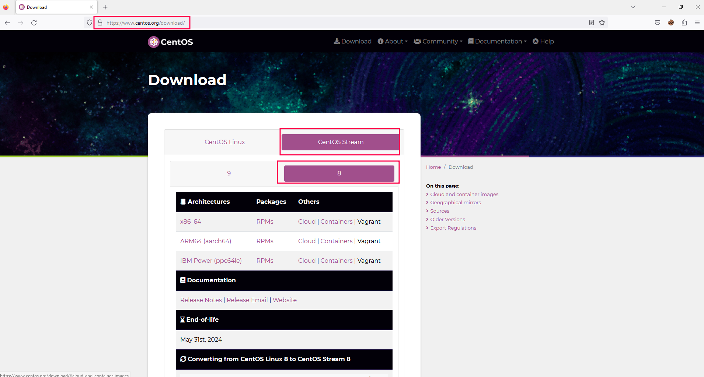
Centos8-Stream Installation
To install CentOS 8 Stream, you can follow these general steps:
  Download CentOS8 Stream from https://www.centos.org/download/
Notes:
Download the CentOS8 Stream as per the link provided. And make the bootable Pendrive/DVD, then insert bootable media in your and boot from the media.

Slide 18
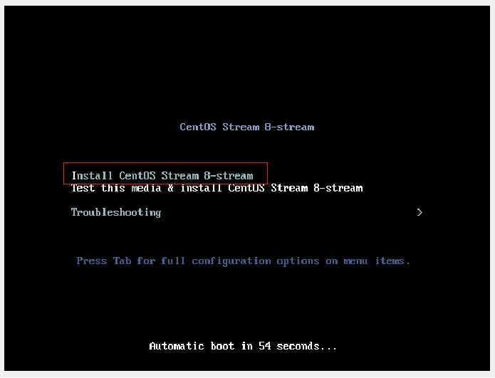
Centos8-Stream Installation - Step-1
Step-1
    The boot screen will be displayed as shown below. Select the first option “Install CentOS Stream 8-stream”.
Notes:
With your PC turned on, plug in your bootable USB drive or insert the CentOS 8 Stream DVD medium and reboot. Make sure to change the boot order in your BIOS settings in order to boot from your preferred boot medium.

Slide 19
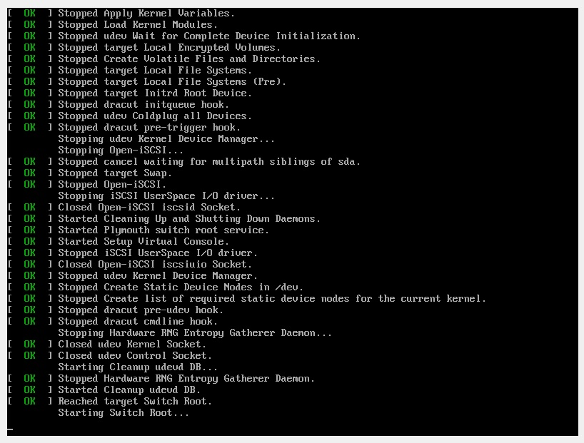
Centos8-Stream Installation – Step1
  Boot messages will follow there after as shown
Notes:
Boot messages will follow there after as shown

Slide 20
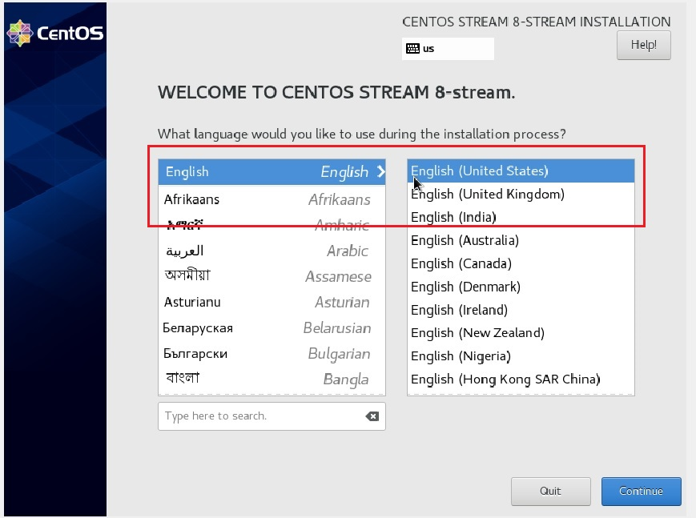
Centos8-Stream Installation – Step-2
  Follow the on-screen instructions to start the installation process.
    Select your language and other preferences.
Notes:
On the ‘Welcome Screen’, choose your preferred installation language and click ‘Continue’.

Slide 21
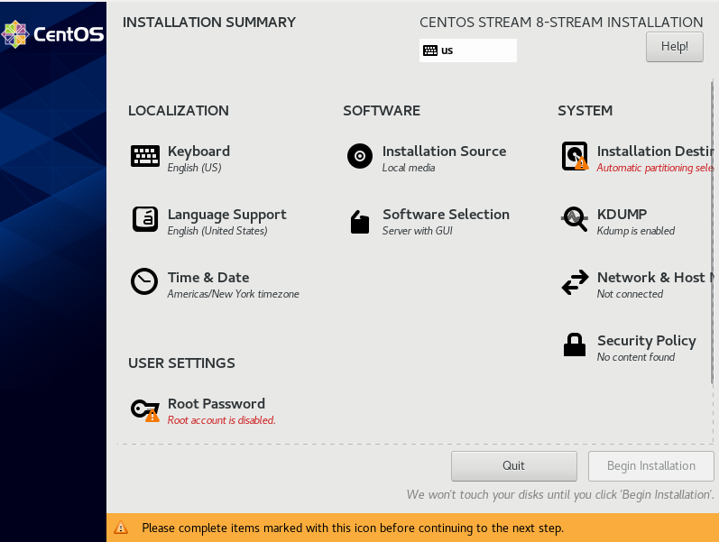
Centos8-Stream Installation – Step-3
  Follow the on-screen instructions to start the installation process.
    After selecting language Installation summary comes like as below image.
Notes:
On the next screen, an installation summary will be displayed presenting all the options that need to be configured as shown. We will configure each of these options in turn.

Slide 22
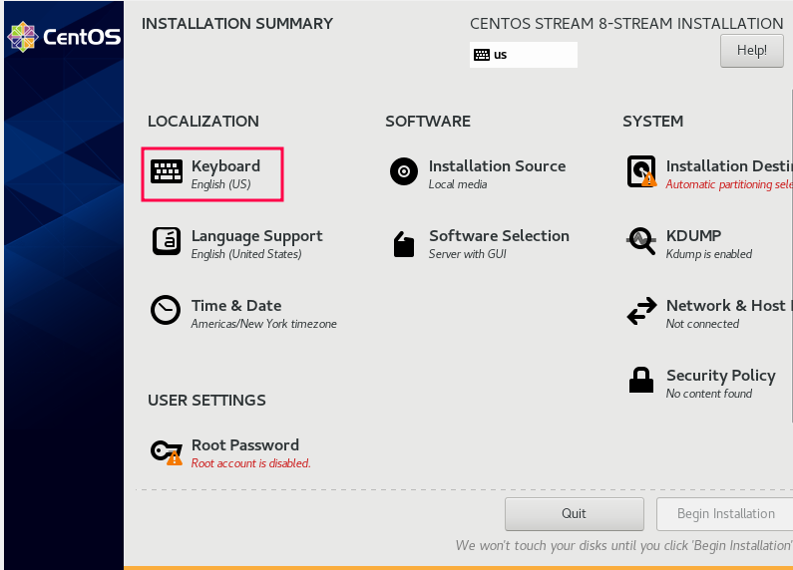
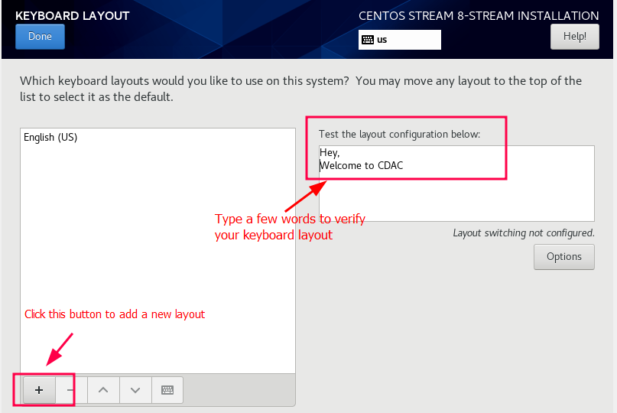
Centos8-Stream Installation – Step-4
  Follow the on-screen instructions to start the installation process.
    Configure Keyboard.
Notes:
Click on the Keyboard option as shown in figure to configure the keyboard .
By default, the keyboard layout is in English (US). At the right Text field, you can type a few words to verify that all is well, and you can type without any glitches with the current layout.
To add a new keyboard layout, click the [+] button at the bottom left of the screen. Next, click ‘Done’ to return to the main menu.

Slide 23
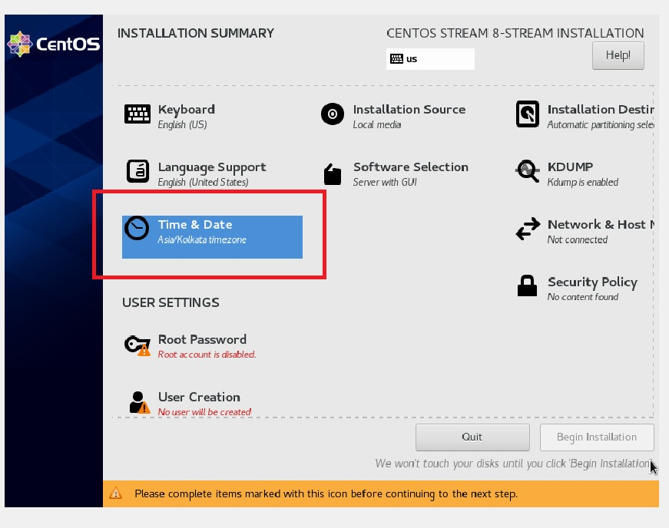
Centos8-Stream Installation – Step-5
  Follow the on-screen instructions to start the installation process.
    Configure Time & Date
Notes:
Next, click on the ‘Time and Date‘ option.

Slide 24
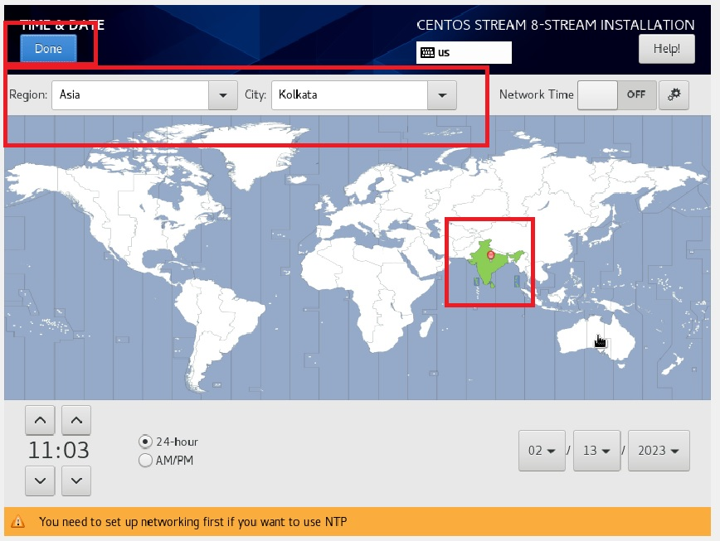
Centos8-Stream Installation – Step-6
  Follow the on-screen instructions to start the installation process.
    Configure Time & Date
Notes:
Next, click on the ‘Time and Date‘ option.
Click on the map as shown to configure the time and date settings based on your location on earth. Also, note the Region and City will automatically be set depending on where you click on the map.

Slide 25
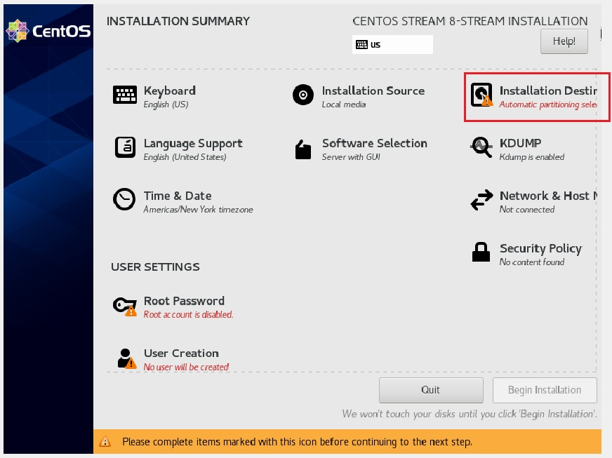
Centos8-Stream Installation- Step -7
  Follow the on-screen instructions to start the installation process.
    Choose the installation destination and partition scheme for the operating system.
Notes:
On the main menu, click on the next option which is ‘Installation Destination’.

Slide 26
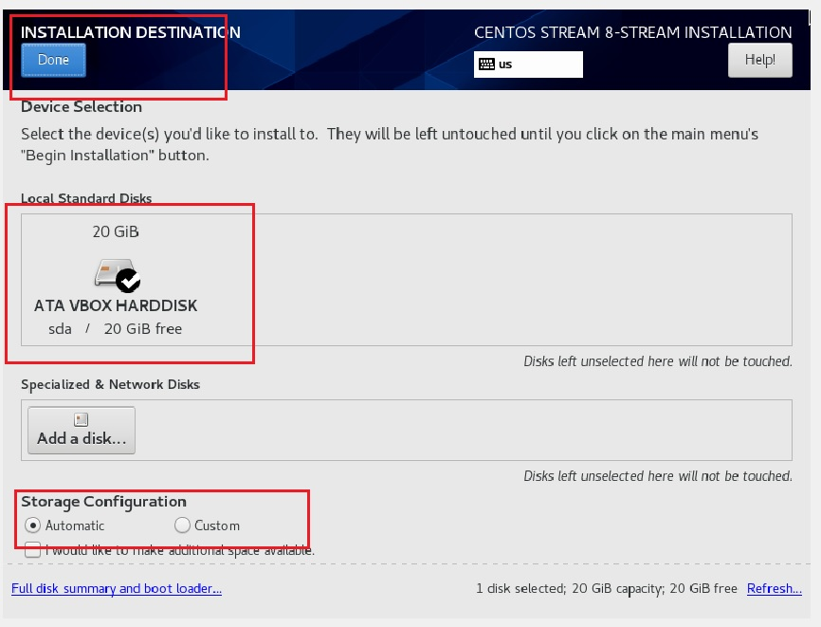
Centos8-Stream Installation – Step-8
  Follow the on-screen instructions to start the installation process.
    Choose the installation destination and partition scheme for the operating system.
Notes:
On the main menu, click on the next option which is ‘Installation Destination’.
In this section, you will determine where to install CentOS 8 Stream and configure the mount points. By default, the installer auto-detects your hard drives and selects the automatic partitioning option. If you are satisfied with the automatic partitioning, click on ‘Done’ to automatically create the mount points. As a beginner go with automatic partitioning

Slide 27
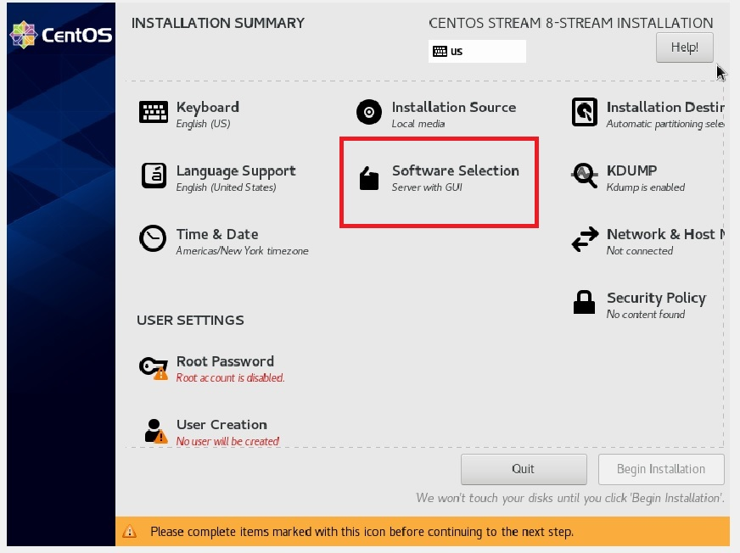
Centos8-Stream Installation – Step-9
  Follow the on-screen instructions to start the installation process.
    Customize your software selection and enable or disable any additional features or repositories.
Notes:
Next, click on ‘Software Selection’.

Slide 28
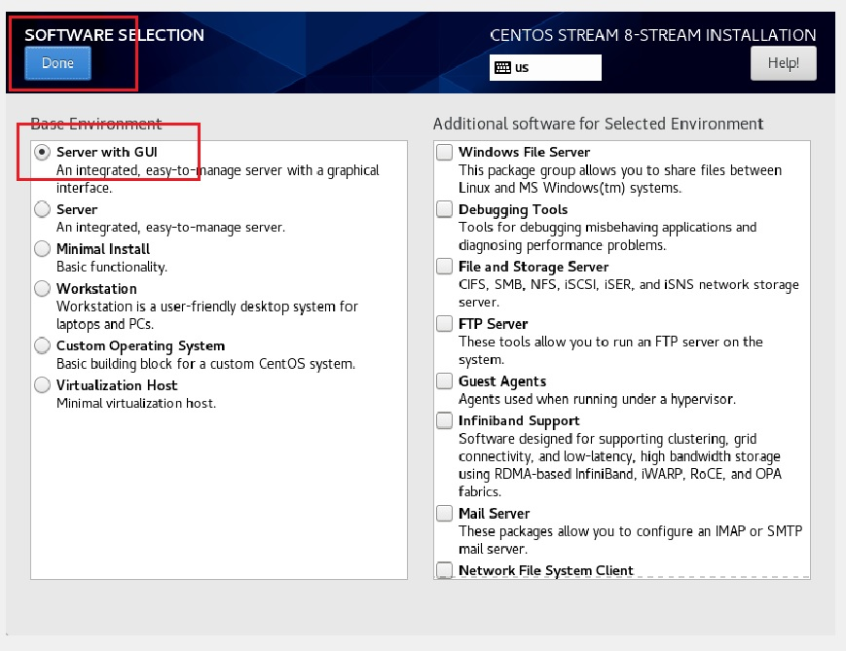
Centos8-Stream Installation - Step10
  Follow the on-screen instructions to start the installation process.
    Customize your software selection and enable or disable any additional features or repositories.
Notes:
Next, click on ‘Software Selection’.
In the next Window, you will be presented with 6 options from which you can select your Base environment and a vast array of Software add-ons which are shipped with respective base environment
In this guide, we have chosen to go with ‘Server with GUI’
After selection process done cline on ‘Done’ button.

Slide 29
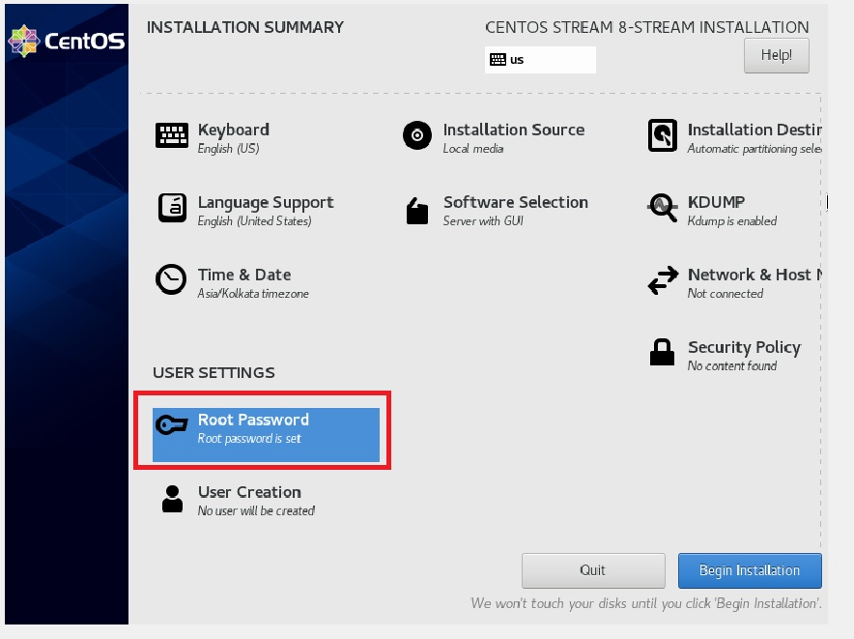
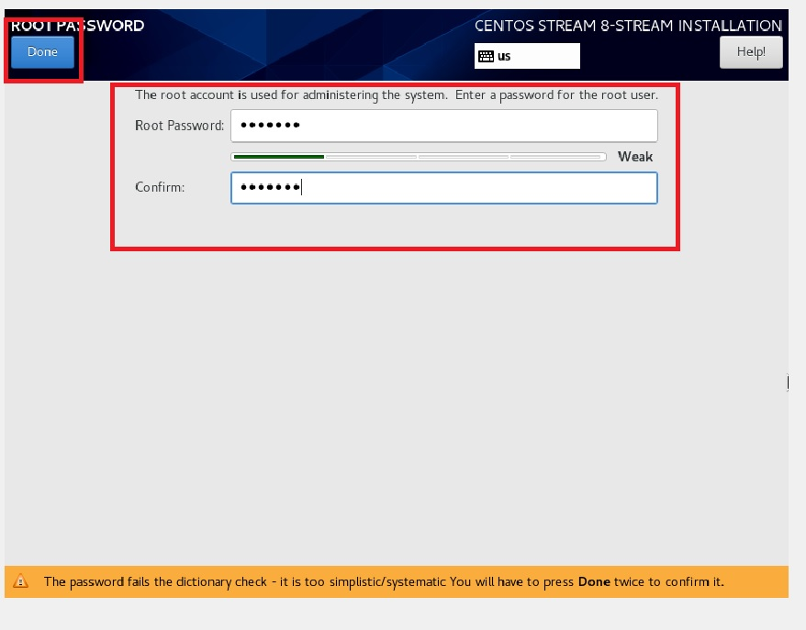
Centos8-Stream Installation – Step-11
  Follow the on-screen instructions to start the installation process.
    Create your user account and password.
Notes:
Next To Create the User Account and also set the password for the ‘root’ user
1. Click on ‘Root Password’ to set the password for the root user.

Slide 30
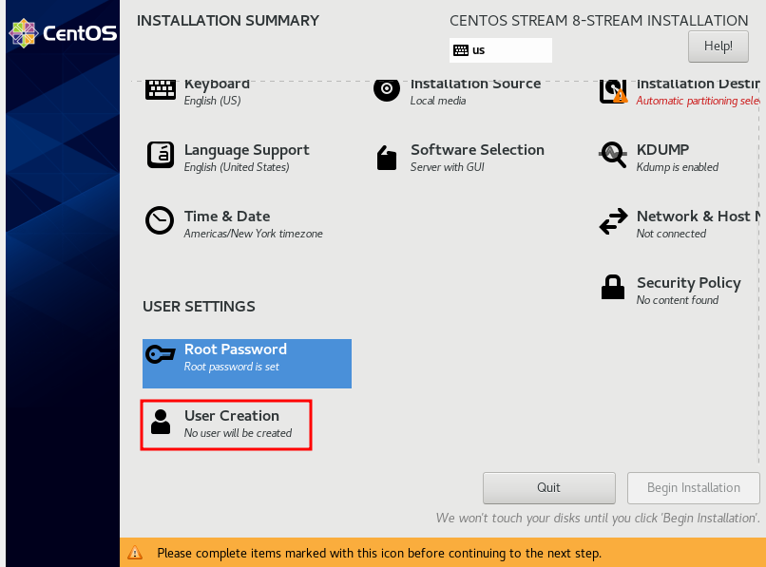
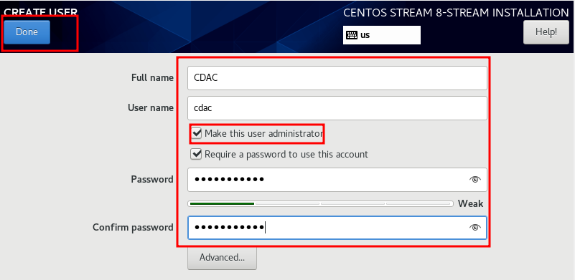
Centos8-Stream Installation – Step-12
  Follow the on-screen instructions to start the installation process.
    Create your user account and password.
Notes:
Next To Create the User Account and also set the password for the ‘root’ user
Click on ‘Root Password’ to set the password for the root user.
To create the user account click on ‘User Creation’
Give the detail of user account and make this user administrator and click on Done button

Slide 31
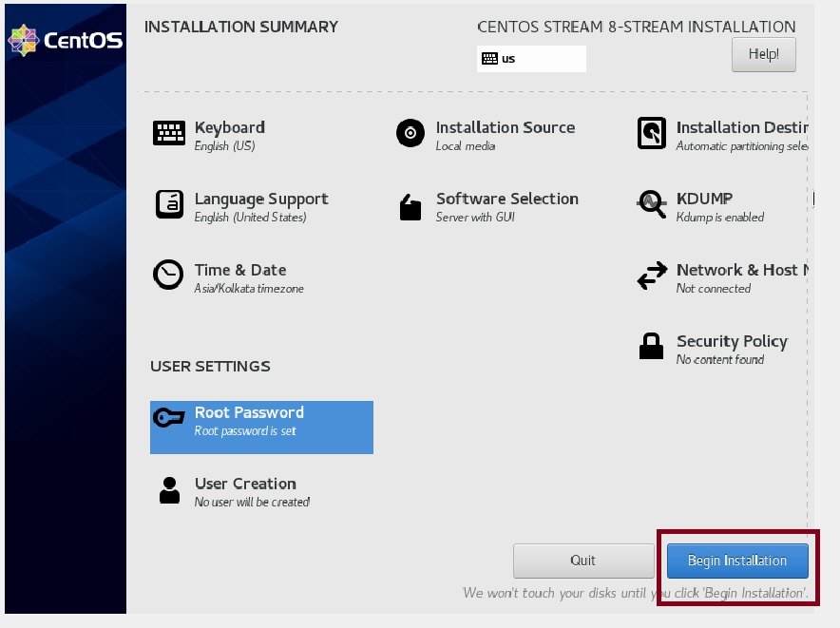
Centos8-Stream Installation- Reboot
  Follow the on-screen instructions to start the installation process.
    Click on Begin Installation button.

Slide 32
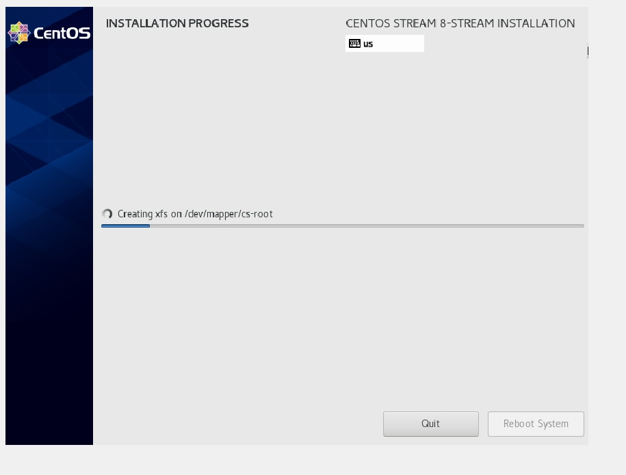
Centos8-Stream Installation
  Follow the on-screen instructions to start the installation process.
    Complete the installation and reboot your system.
Notes:
After completion of installation click on the Reboot System, and also make sure Bootable should be unpluged

Slide 33
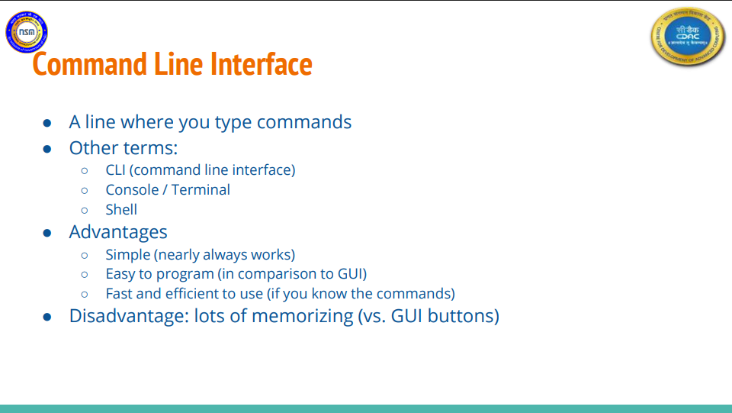

Slide 34
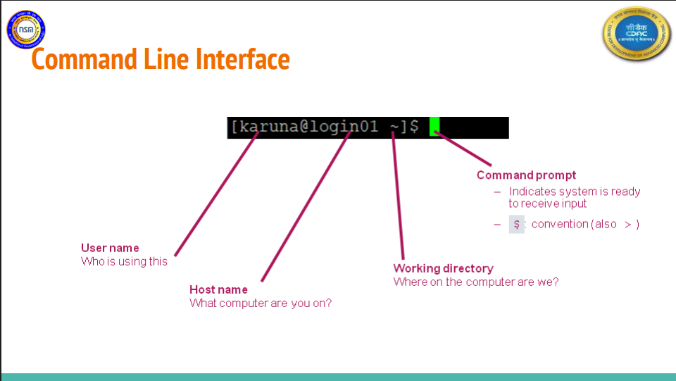

Slide 35
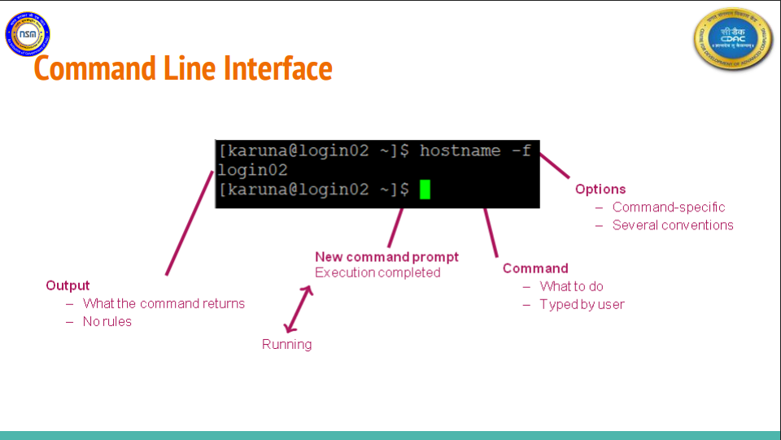

Slide 36
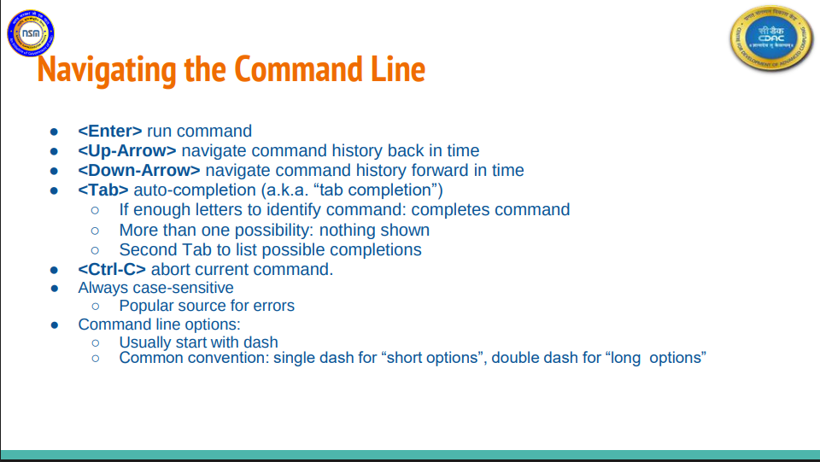

Slide 37
Basic Commands
ls
cp
mv
lpr
sort
grep
cat
tac
more
ps
head
tail
man
whatis
whereis
locate
find
diff
file
jobs
rm
mkdir
rmdir
cd
pwd
ln
gzip
gunzip
tar
whomi
zcat
cal
bc
date
banner
wc
touch
echo
who
w
Notes:
Linux basic commands are a set of commands used to perform various operations on a Linux-based operating system. These commands can be used in a terminal or command-line interface to navigate the file system, manage files and directories, modify system settings, and execute various tasks. Some commonly used basic commands in Linux are shwon here and lets discuss each one by one.

Slide 38
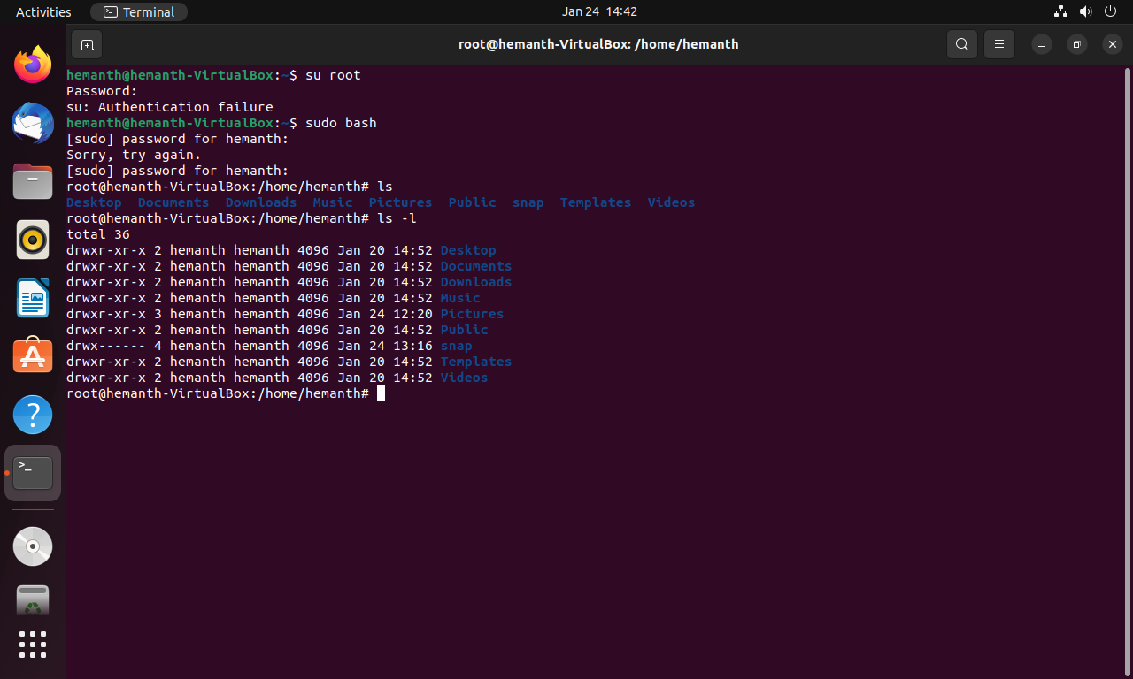
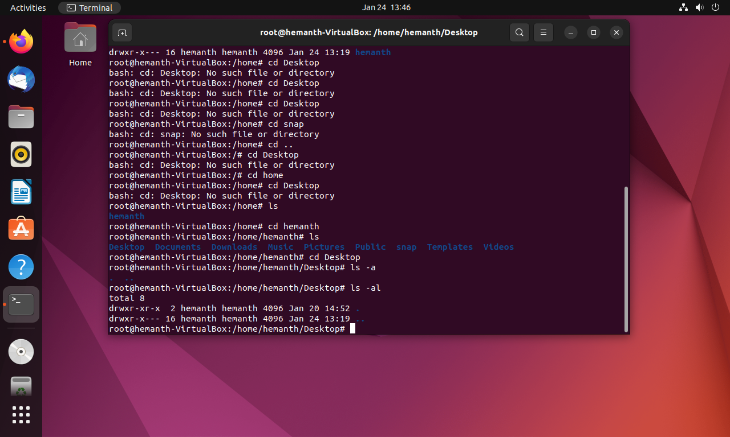
Command - ls
Ls is used to show the content of the present working directory.
Notes:
Ls is the basic and most used command in Linux, and it is used to show the content of the present working directory. Following screenshots shows the sample output of the ls command. There are so many command line options available for the ls command. For example ls –l command will display the content of the present working directory in file listing format as shown in the left figure. The properties of the folders in the directory are also shown in the figure.
In the results: the “d” represents the list item is a directory otherwise it will be a “-” for regular files. After that, there are file permissions for read/write/execute. The Number 2 represents how many links/shortcuts are for the available file, but for a directory, it is the number of sub-directories. The next 2 names are the owner of the file and the group to which the file belongs. Then it is the size of the file, Followed by the date & time on which the file had created
In the next figure Ls –a shows the hidden directory, any hidden file in Linux starts with ‘.’. We can combine 2 arguments like ls –al which show listed hidden files

Slide 39
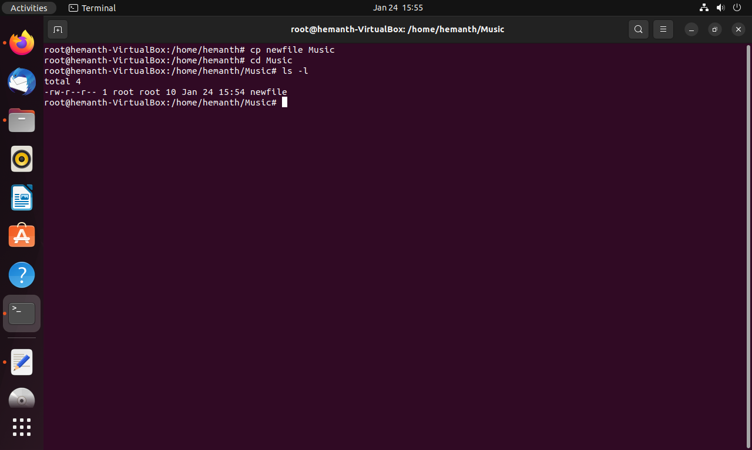
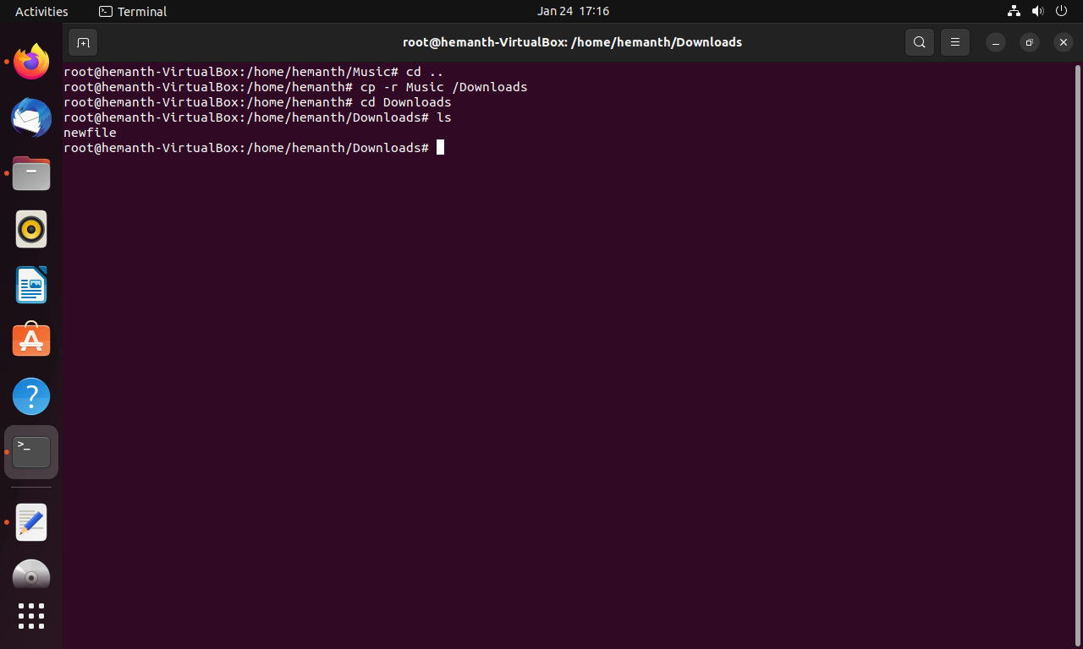
Command cp
The cp command in a Unix-like operating system is used to copy files and directories from one location to another.
Notes:
The command "cp" stands for copy.
This command is used to copy files, a group of files, or a directory. It creates an exact image of a file on a disc with a different file name. The cp command requires at least two filenames in its arguments. You have to specify the source file and destination folder as arguments.
In the example (Figure 1), we copy a file named "newfile" to the destination directory, Music.
The cp command doesn’t delete the original file. To copy the whole content of a directory, we use the –r option with the cp command. That will recursively copy the contents.
in the second figure
It recursively copies the music directory to Downloads.

Slide 40
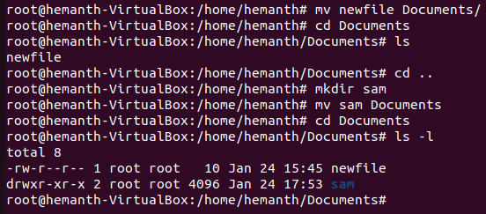
Command “mv”
The mv command in a Unix-like operating system is used to move or rename files and directories.
Notes:
The mv command will delete the original file and paste it in a specific location. We can also cut and paste the directory in the same way. In contrast to the cp command, the mv command does not use the -r option for directories.

Slide 41
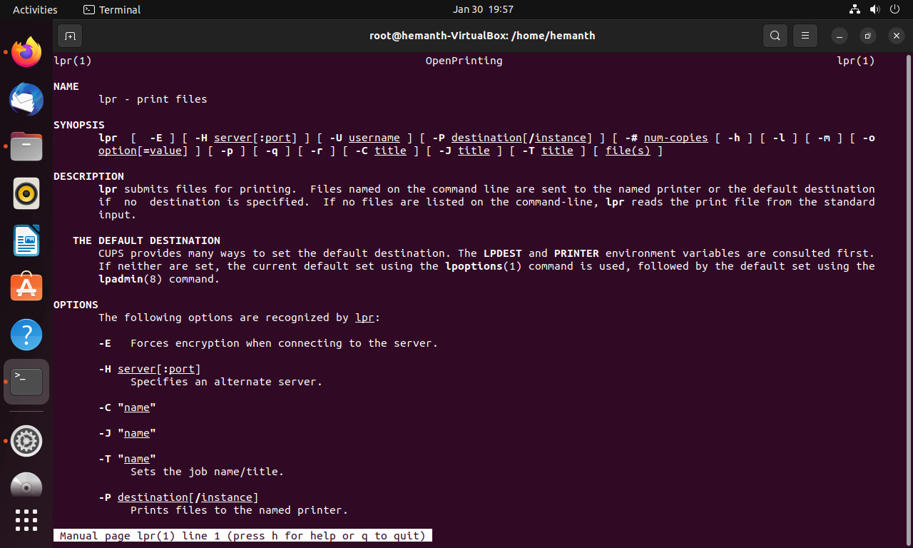
Command lpr
The lpr command is used in a Unix-like operating system to send files to a printer for printing.
Notes:
Now this command is not being used, but earlier it was used for line printing.
If you have an interconnected printer on your system and want to print some files, you have to specify the file name and printer name with the lpr command.
If you don’t specify the printer name, the file will print using the default printer on the system.

Slide 42
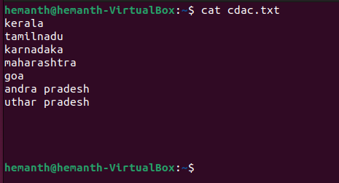
Command cat
The cat command in a Unix-like operating system is used to display the contents of one or more files to the standard output (usually the terminal).
Notes:
Cat(concatenate) command is very frequently used in Linux. It reads data from the file and gives their content as output. It helps us to create, view, concatenate files.It will show the content of the file only. We cannot modify the content using the cat command.
You can use various options with the cat command to modify its behavior, such as concatenating multiple files, creating a new file with redirected output, and more.

Slide 43
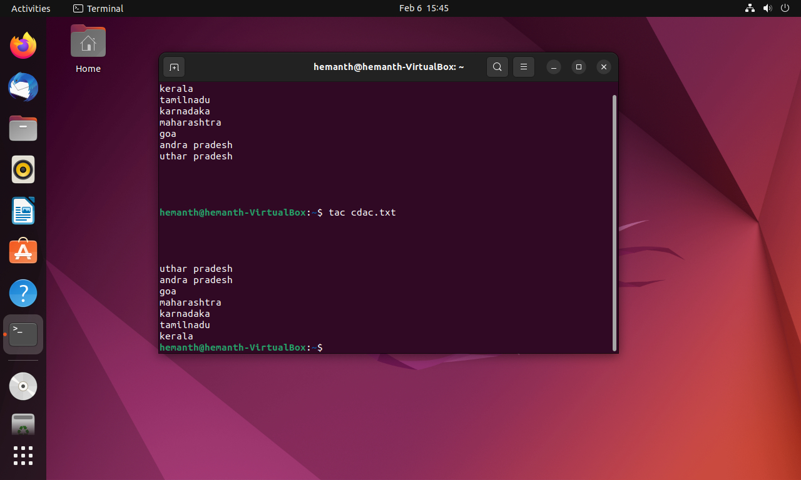
Command tac
The tac command is just the opposite of the cat command.
It will show the content of a file in reverse format.
Notes:
The "tac" command is a Unix/Linux command that is used to print the lines of a file in reverse order, starting from the last line and ending with the first line. Its name "tac" is the reverse of "cat," It is also known as 'cat' backward, which is a command used to concatenate and display files.

Slide 44
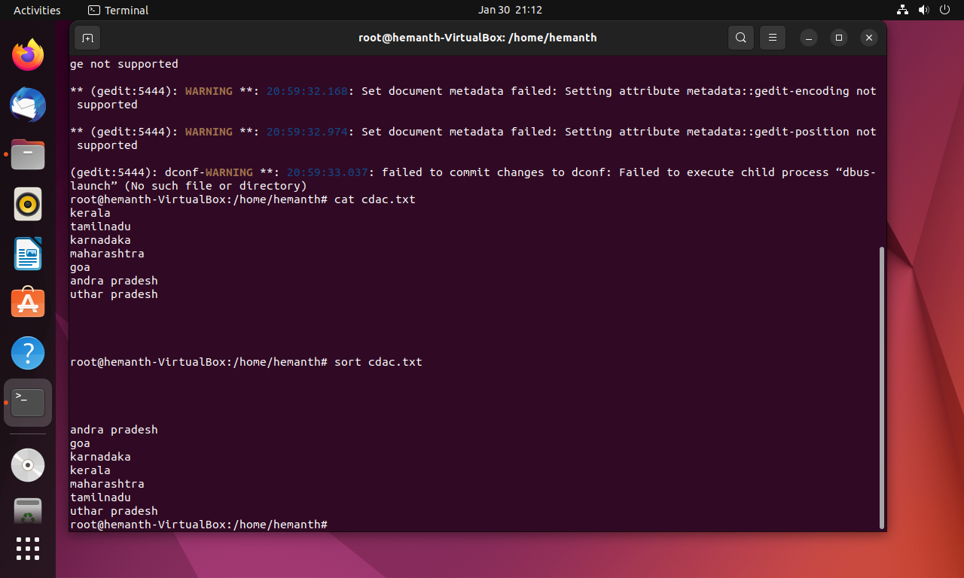
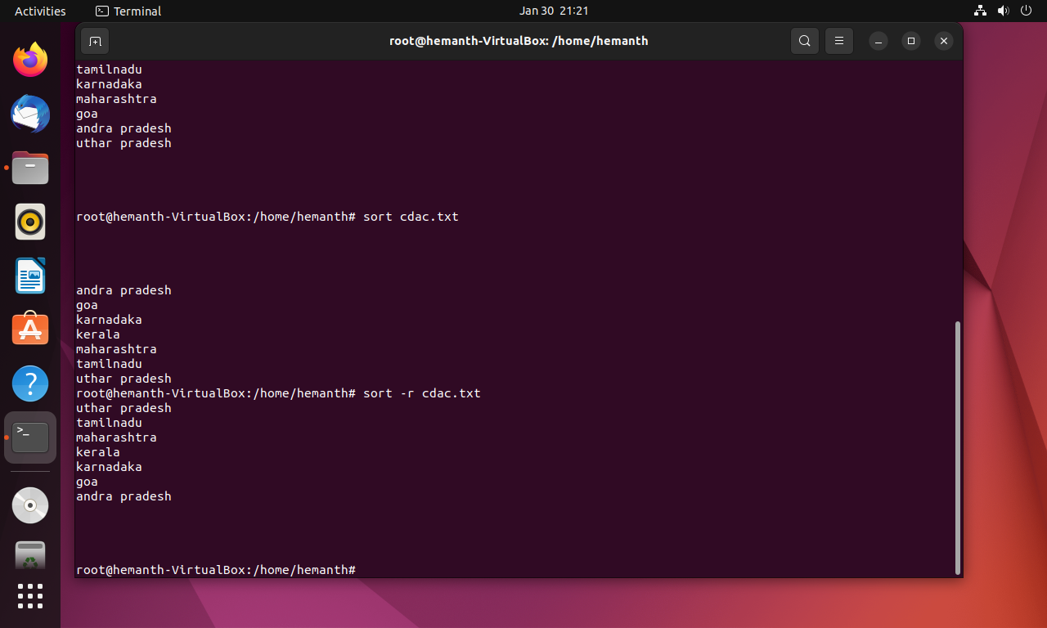
Command sort
The sort command in a Unix-like operating system is used to sort lines of text in a file or from standard input.
Notes:
The sort command will sort the content of the specified file.
It will sort in ascending order by default.
The sort-r command will sort the file in descending order, as illustrated in the second figure.

Slide 45
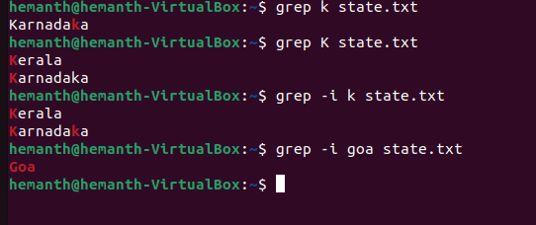
Command grep
The grep command in a Unix-like operating system is used to search for text patterns in one or more files or from standard input.
Notes:
The Grep command is used for pattern searching in a file.
Grep will print each line that matches the pattern.
Linux is case-sensitive. operating system, so we use the –i option with grep to cancel the case sensitivity.
If no file is specified, the grep command reads from standard input. The grep command can search for exact matches or use regular expressions to match more complex patterns. You can use various options with the grep command to modify its behavior, such as selecting case sensitivity, searching recursively, displaying line numbers, and more.

Slide 46
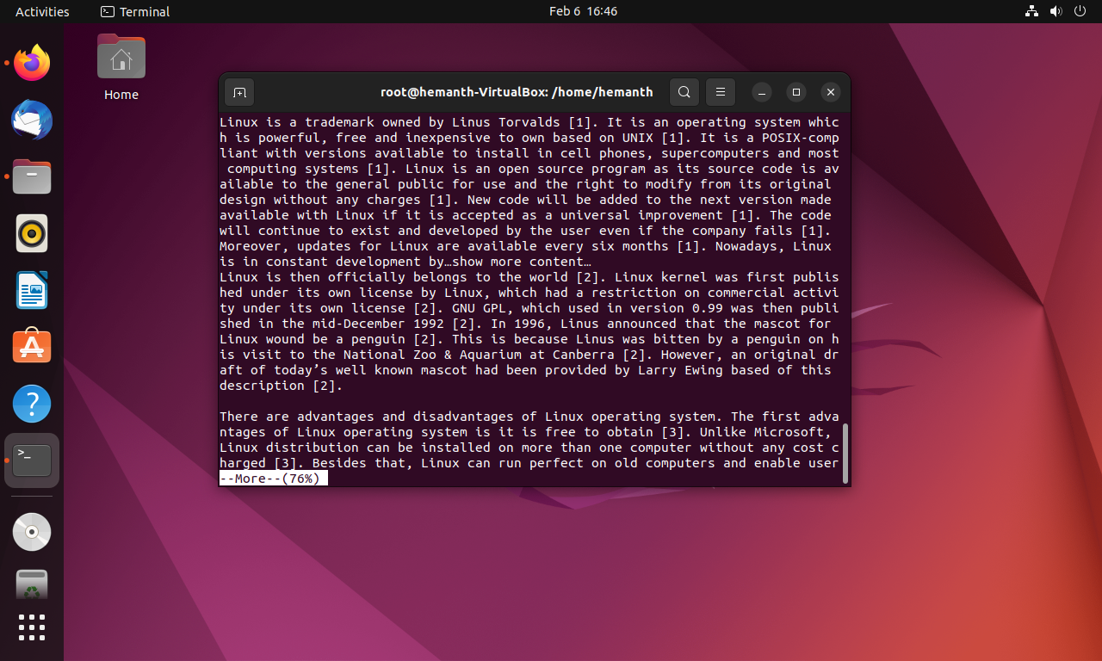
command “more”
The "more" command is a Unix/Linux command that is used to display the contents of a file one screen at a time. It is often used to view large text files and allows you to scroll through the file using the spacebar or the enter key.
Notes:
More command is used to display lengthy file in page by page . The more command reads files and displays the text one screen at a time. The command pauses after each screen and prints the word More at the bottom of the screen. If you then press a carriage return, the more command displays an additional line.

Slide 47
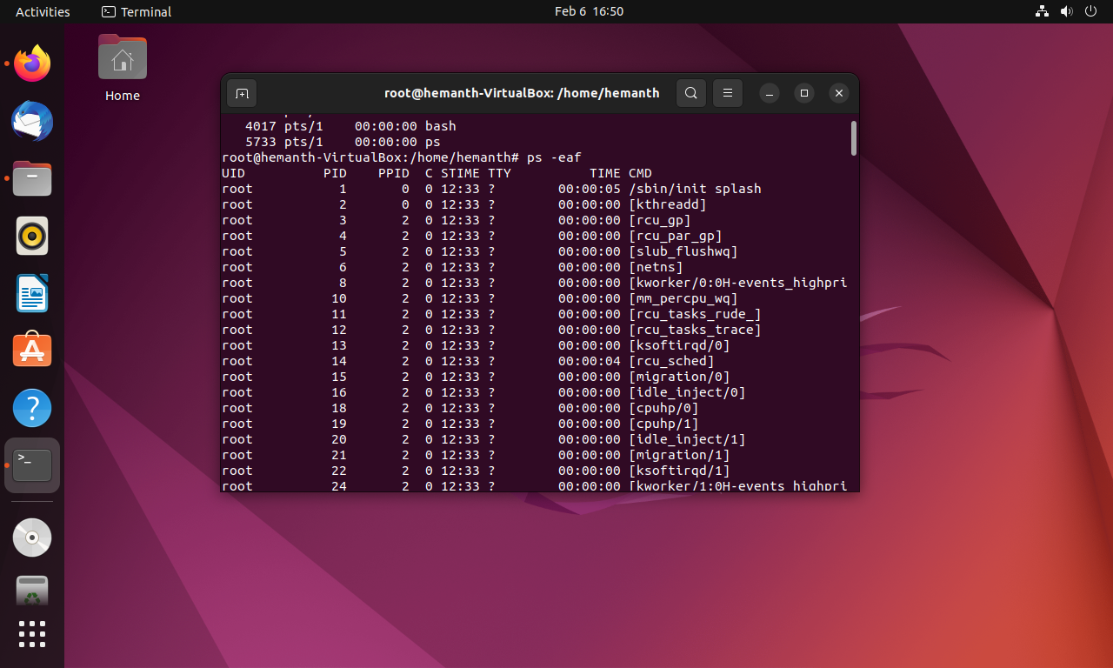
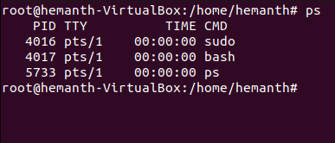
Command ps
It will shows the processes that are running in the shell and also list information about running processes on the system
Notes:
The ps command is used to view currently-running processes on the system. It helps us to determine which process is doing what in our system, how much memory it is using, how much CPU space it occupies, its user ID, command name, etc. By default, it shows information about processes that are running under the same user as the command is being executed, including the process ID (PID), CPU usage, memory usage, and status.
-eas option along with this command will show all the processes that are actually running inside the Linux system. e will show all the processes, a will show processes including system processes, and f will show the format.

Slide 48
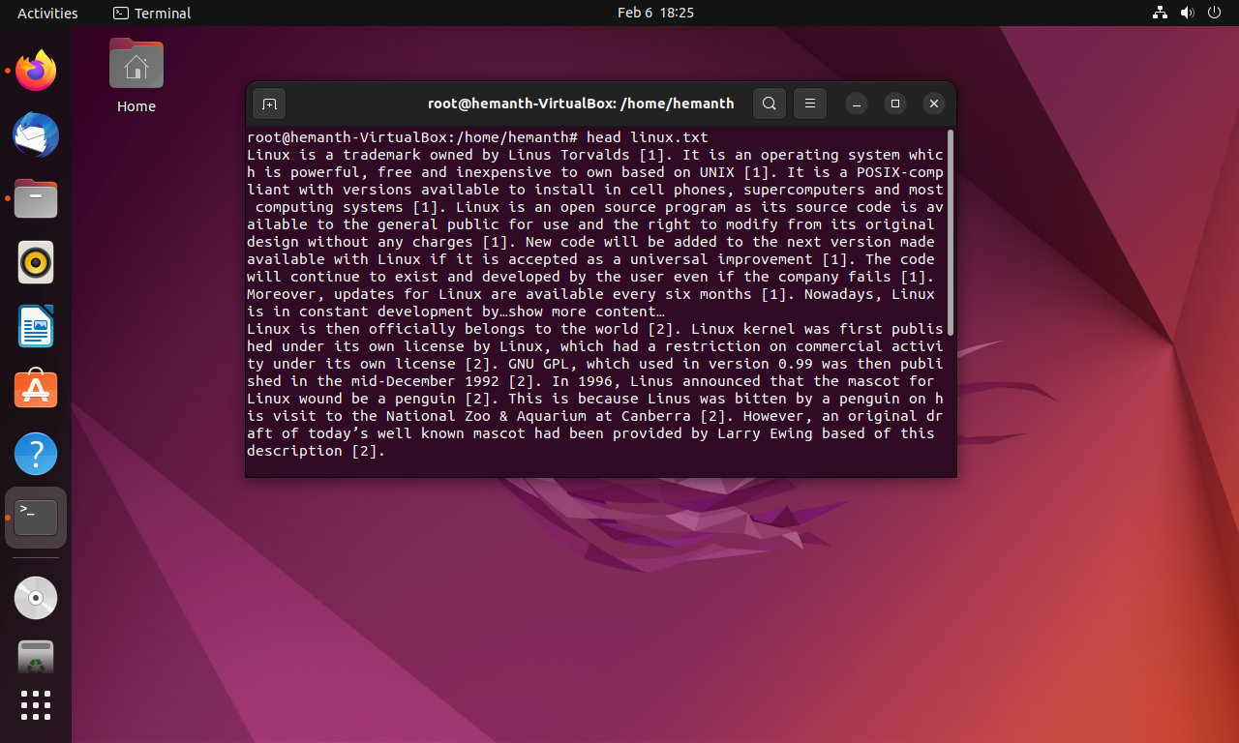
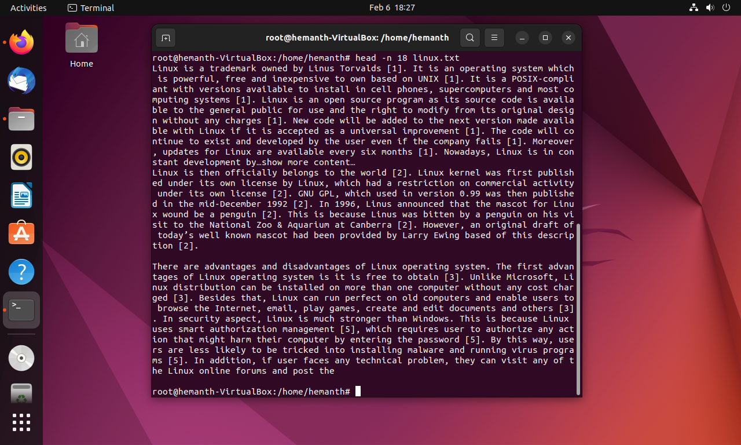
Command head
displays the first few lines of a file or input.
Notes:
The Linux head command prints the first lines of one or more files (or piped data) to standard output. By default, it shows the first 10 lines. However, Head provides several arguments you can use to modify the output. The -n option allows us to change the number of lines. In Figure 2, we used head -n 18; it will display 18 lines from the start.

Slide 49
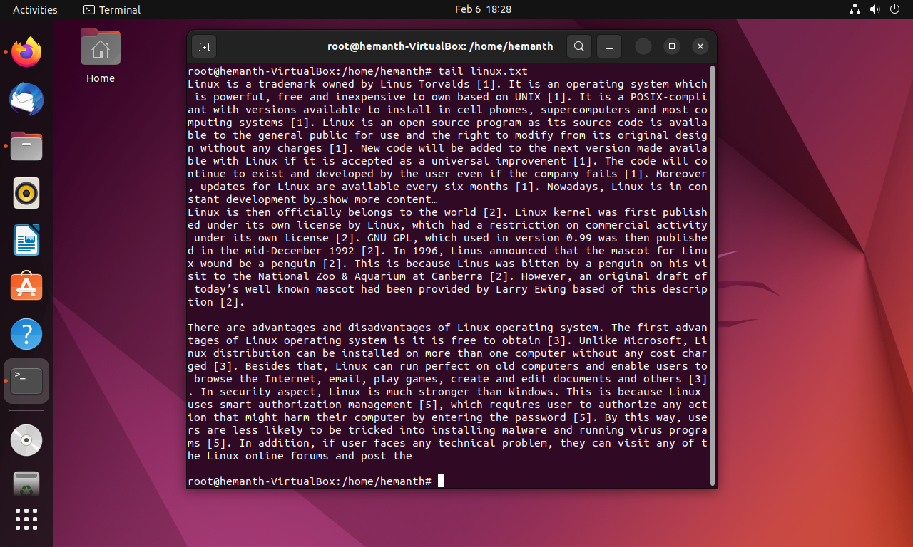
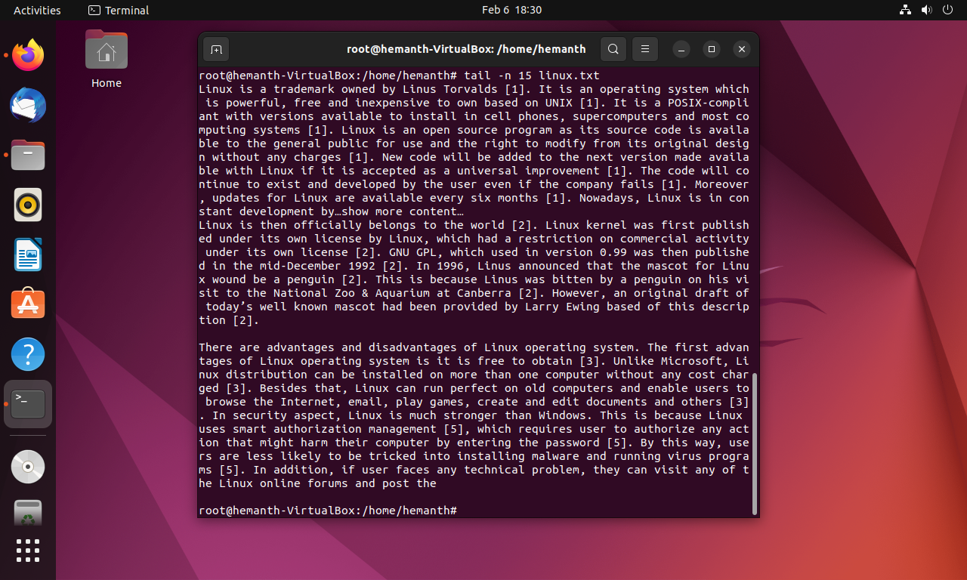
Command tail
displays the last few lines of a file or input
Notes:
It is the complement of head command. The tail command, as its name implies, prints the last N lines of the given file. We can also change the number of lines to show by using the –n option as in head command

Slide 50
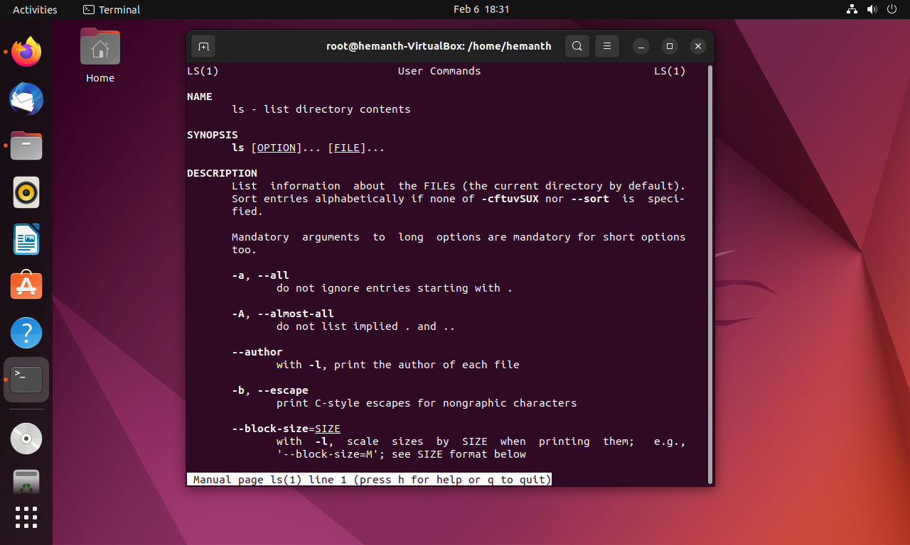
command man
It will show the complete manual for a particular Linux command
Notes:
The man command in Linux is used to display the user manual of any command that we can run on the terminal. It provides a detailed view of the command which includes name, synopsis, description, options, exit status, return values, errors, files, versions, examples etc.

Slide 51
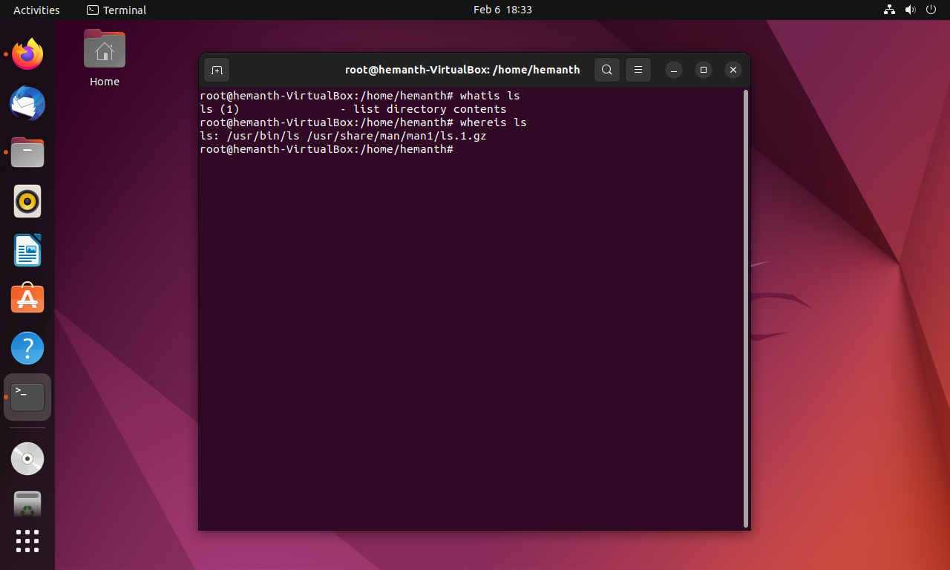
Command whatis
It will show one-line manual page description of a command
Notes:
The "whatis" command is useful for quickly finding out what a particular command does, without having to read the entire manual page using the "man" command. When you run the "whatis" command followed by a command name, it will display a brief one-line description of the command.

Slide 52
Command whereis
is used to locate the binary, source code, and manual page files for a given command or program.
Notes:
It will display the location of the command in your directory. It is typically used to determine the location of system files associated with a particular executable program or utility.

Slide 53
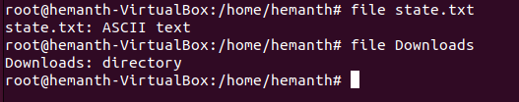
Command file
It will show what type of file that you given as an argument
Notes:
If you want to know a file type, then you have to use this command and the file name as arguments. In the above example, the state file is an ASCII text file, and the downloads is a directory.

Slide 54
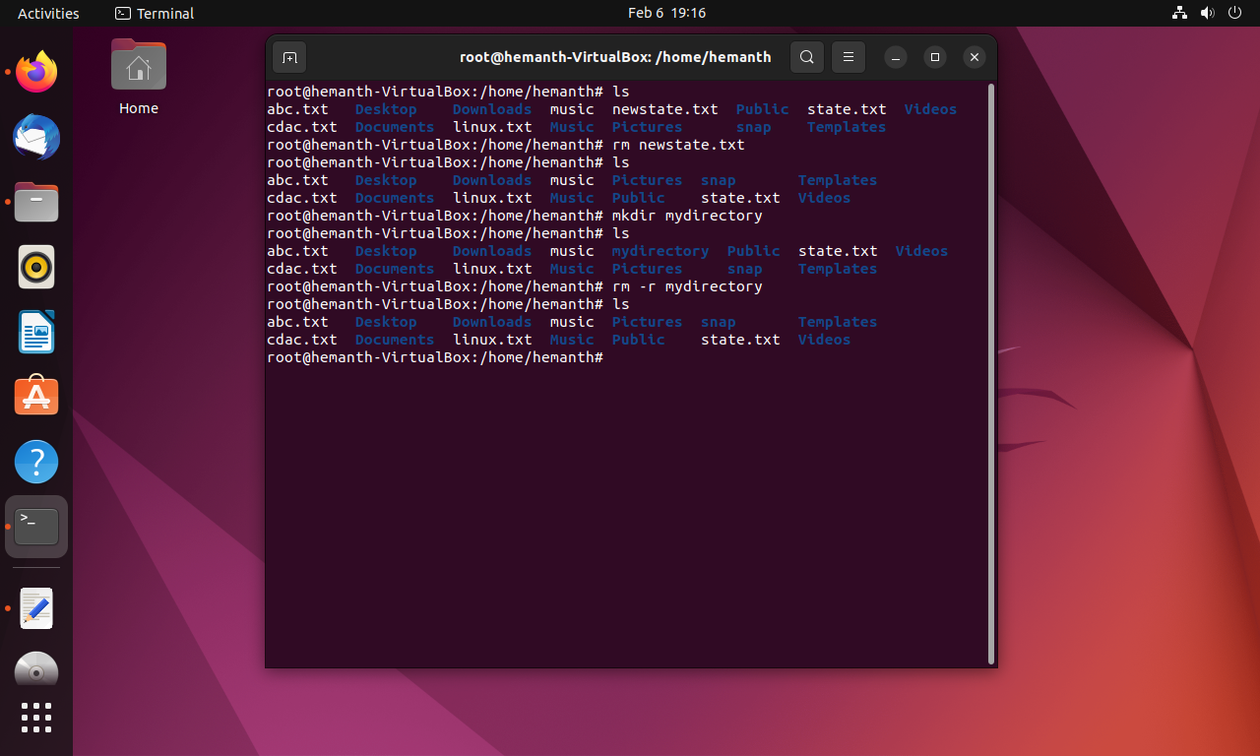
Command rm
It is one command to remove a file
Notes:
We cannot remove directories by only using the rm command. We have to use the –r option along with rm to recursively remove the directory. The -rf option will forcefully remove the directory; it will directly remove the contents without asking. If we use * along with –rf, it will remove the whole content from the directory. It is very dangerous to use –rf* without knowing the current location. because if we are in the root, it will delete complete OS files.

Slide 55
command mkdir
It is used to create a directory
Notes:
The mkdir stands for 'make directory'. With the help of mkdir command, you can create a new directory wherever you want in your system.

Slide 56

Command rmdir
It is used to remove a directory
Notes:
The rmdir command removes the directory, specified by the Directory parameter, from the system. The directory must be empty before you can remove it, and you must have write permission in its parent directory.

Slide 57
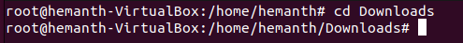
Command cd
used to change the present directory
Notes:
Linux cd command is used to change the current working directory ( i.e., in which the current user is working). The "cd" stands for 'change directory. ' It is one of the most frequently used commands in the Linux terminal.

Slide 58
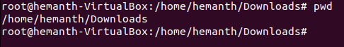
Command pwd
It is used show present working directory
Notes:
The pwd command writes to standard output the full path name of your current directory (from the root directory). All directories are separated by a / (slash). The root directory is represented by the first /, and the last directory named is your current directory.

Slide 59


Command diff
Used find difference between the files
Notes:
diff stands for difference. This command is used to display the differences in the files by comparing them line by line.
No output will be shown when both file contents are the same, as illustrated in Figure 1. If the files are not identical, the output will instruct you to add or delete lines to make them so. Suppose, in the above example, the output is 1a2. This means that to make the files identical, you have to add the line "Hinamshu" in between lines 1 and 2. Other than "a," we have "c" for changing the line and "d" for deleting the line.

Slide 60

Command ln
It is the Command to create link/shortcut to a file
Notes:
It will create a shortcut to the file .in the above example we create a link istate to the file state .
The ln command links the file designated in the Source File parameter to the file designated by the Target File parameter or to the same file name in another directory specified by the Target Directory parameter. By default, the ln command creates hard links.

Slide 61

Command jobs
Jobs command is a command-line utility in Unix and Unix-like operating systems that is used to display the status of jobs running in the background of a terminal or shell environment.
Notes:
This command will show which jobs are currently running on your shell. The jobs command displays a list of all jobs running in the current shell session, along with their status, job number, and the command used to start them. The status of a job can be one of several states, including running, stopped, or completed.
-l option list PIDs ( process id) in addition to default information. -n will list only processes that have changed since the last notification. -p option will list PIDs only. -r will show only running jobs. and the -s option displays only jobs that have been terminated.

Slide 62

Command find
It will find a file or folder by name inside the full directory
Notes:
It will find a file or folder by name inside the full directory. In contrast to the locate command, it will search for the file in the whole Linux directory.
It recursively searches a specified directory and all of its subdirectories for files and directories that match a set of criteria, such as name, size, modification time, and permissions.

Slide 63

Command locate
is used to search for files and directories in a filesystem.
Notes:
It will locate the directory or file using their name, and the result will be the path of the input file. It works by maintaining a database of files and their locations, which is updated periodically by a background process. When a user runs the locate command with a search pattern as an argument, the utility queries the database to find any files or directories that match the pattern.

Slide 64

Command gzip
Used to create zip files
Notes:
If you want to compress a file, you can use a command called gzip. It will compress the specified file and delete the original. In the above example, we can see that the cdac.txt file is compressed to gz format and the original file is deleted.

Slide 65

Command gunzip
It will unzip file
Notes:
Gunzip works in the opposite way to gzip in that it extracts the compressed file. It will unzip, and the original file will be restored.

Slide 66

Command tar
This command will archive group of files
Notes:
Tar is a commonly used Linux command. The tar command is used to compress a group of files into an archive. The command is also used to extract, maintain, or modify tar archives. Tar archives combine multiple files and/or directories into a single file. This command will create a tar file that contains the archived files.
We use the cvf option along with file names to archive those files. c means to create a tar file. v- stands for "verbose," which refers to whatever is displayed on the screen, and f- stands for "create files."After entering the command, we can see that a tar file is created, including those files, but the original file is not deleted. We can also archive folders.
The -tvf option will show the content of a particular archived file.
To extract tar files, you have to use the -xvf option. All archived files will be in their previous form.

Slide 67

Command whoami
This command will give the information about user who is currently logged in
Notes:
The whoami command allows Linux users to see the currently logged-in user. The output displays the username of the effective user in the current shell. Additionally, whoami is useful in bash scripting to show who is running the script.

Slide 68

Command zcat
This command will show the content of the zip file
Notes:
By the zcat command We can show the content of the compressed file without extracting it. cdac.txt.gz is a text file that is zipped. Using the zcat command, the content of the zip file is shown here.

Slide 69

Command cal
It is used to show calendar of the system on your shell
Notes:
Cal will display the current month's calendar in the shell.The date command is used to display the current date.

Slide 70

Command bc
In Linux, bc command is to use calculator
Notes:
Using the bc command, we can easily use a calculator in shell.
If you enter the expression, the result will be in the next line, as shown in the figure.

Slide 71

Command date
This command will show the current system date and time
Notes:
The -s option allows you to set or change the date and time. If you do not use the -s option, the current system date will be displayed.

Slide 72

Command wc
This command will count the number of words in a file
Notes:
Wc command is widely used in shell scripting .
When you use wc command along with a filename The output will be 3 sets of numbers
First Number is the total number of lines in the files
2nd is the total no of words in the file
3rd is the total character numbers
We can also take these counts individually
-l option gives you only the number of lines .-c option will gives you the total number of character only, and -w option is to show the number of word only
In the above example for the state file there is 8lines,72 characters ,and 9 words are there

Slide 73

Command touch
Touch will create an empty file
Notes:
Touch command is used to create a file without any content. The file created using touch command is empty. This command can be used when the user doesn’t have data to store at the time of file creation.

Slide 74

Command echo
Print messages on to the console
Notes:
echo command is used to display line of text/string that are passed as an argument . This is a built in command that is mostly used in shell scripts and batch files to output status text to the screen or a file.

Slide 75

Command who
This command is to check which users are logged in to the system
Notes:
The who command is a tool to print information about users who are currently logged in. who only see a real user who is logged in. If multiple users are logged on to the system, we can list the total number of users with this command.

Slide 76

Command w
W command will shows the status of the system
Notes:
w command in Linux is used to show who is logged on and what they are doing. This command shows the information about the users currently on the machine and their processes.

Slide 77
Network Commands
Ping
telnet
Ssh
ftp
Sftp
finger
Notes:
These are some basic network commands that are used for network purposes. We commonly use the ping command to troubleshoot network issues. and the ssh command is used to remotely log into a system.

Slide 78

Command ping
Ping command is used for network trouble shooting
Notes:
It is used to check if the system is running or not. It is a network troubleshooting command that will send an ICMP echo packet to the server system, and the system will reply with ICMP. In the above figure, we are pinging the system, and it is replying back. To stop the pinging, you have to press ctrl+c. In this example, 20 packets are transmitted and 20 are received, which means that the system is replying. From this, we can understand that this system is up. If we are not getting any reply, the system is either down or a firewall is running.

Slide 79

Command SSH
This command is used to remotely log in to a system
Notes:
Telnet and SSH are simply commands for remotely logging into a system at 10.182.0.11. So we have to specify the user name, and here it is root. Any Linux OS will have a root user, which is the superuser, who has full admin power. This command will remotely log in to the system as root. After that, it will ask for a password. If I type the password, then only I will be able to log in to the system.

Slide 80
Summary
In this chapter you have learnt:
Basics of Unix and Linux Operating System
Concept of Open source Software and Types of Licenses
Various distributions of Unix and Linux
The difference between Linux and Unix
Installation of CentOS-8 Stream Operating System
The essential Linux commands
Notes:
In this chapter you have learnt:
Basics of Unix and Linux Operating System
Concept of Open source Software and Types of Licenses
Various distributions of Unix and Linux
The difference between Linux and Unix
Installation of CentOS-8 Stream Operating System
The essential Linux commands

Slide 81


